Slide 1
How we got here

Slide 2
“It takes a thousand people to invent a telegraph, or a steam engine, or a phonograph, or a telephone or any other important thing—and the last one gets the credit and we forget the others. He added his little mite—that is all he did. These object lessons should teach us that ninety-nine parts of all things that proceed from the intellect are plagiarisms, pure and simple; and the lesson ought to make us modest. But nothing can do that.”
–Mark Twain
Notes:
It takes a thousand people to invent a telegraph, or a steam engine, or a phonograph, or a telephone or any other important thing—and the last one gets the credit and we forget the others. He added his little mite—that is all he did. These object lessons should teach us that ninety-nine parts of all things that proceed from the intellect are plagiarisms, pure and simple; and the lesson ought to make us modest. But nothing can do that.

Slide 3
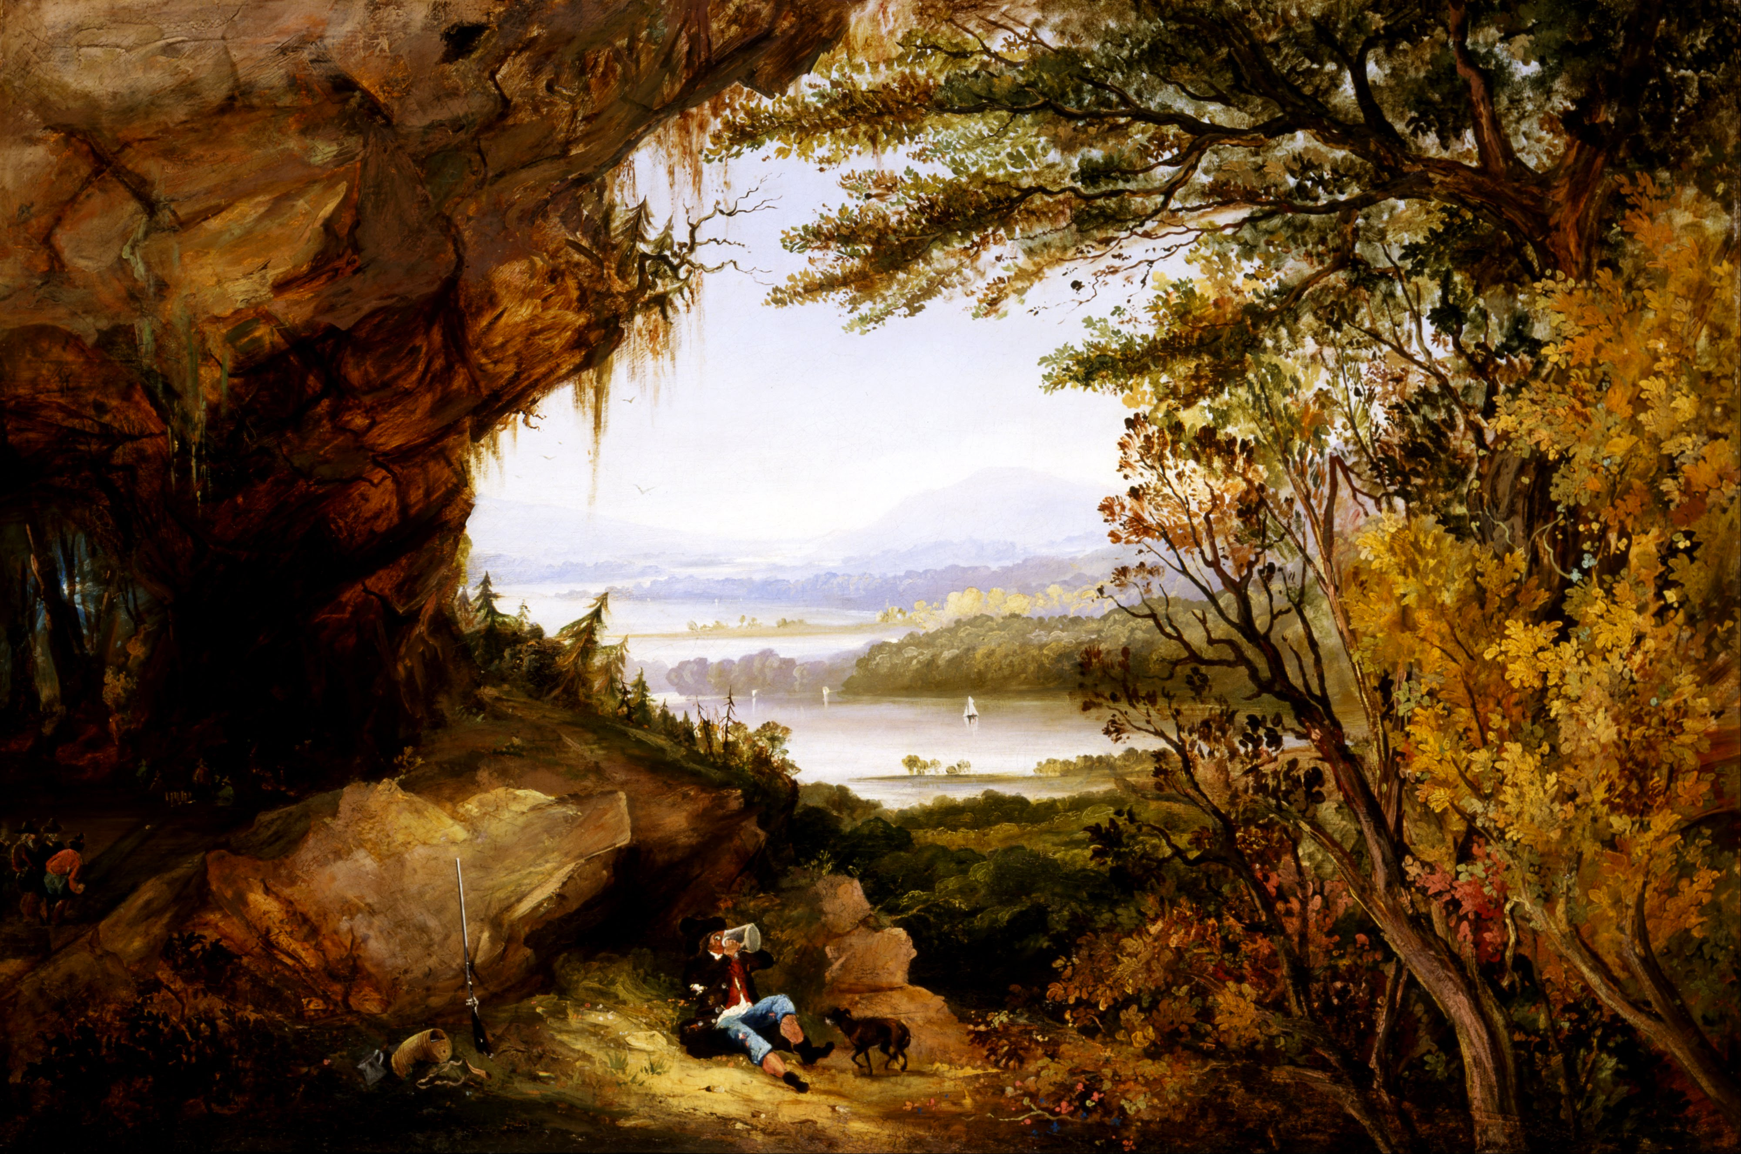
Notes:
(Washingon Irving, 1819) In the years leading up to the American Revolution
Rip Van Winkle lived in the Catskill Mountains near the Hudson River, not far from an important chapter of our story is set. Rip van Winkle goes hunting in the woods, encounters a mysterious ritual, drinks some moonshine, and falls asleep.
When he awoke his beard was long, his musket was rusted, and his dog was gone. He returned to his village to discover that his country had become independent and his children had grown up. He had been asleep for twenty years.

Slide 4
Prologue

Slide 5
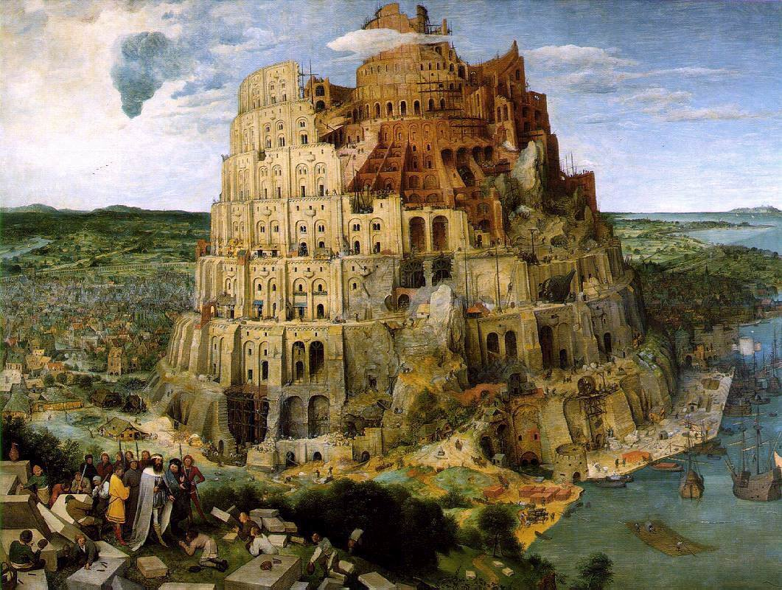
The Tower of Babel
Pieter Brueghel the Elder (1563)

Slide 6
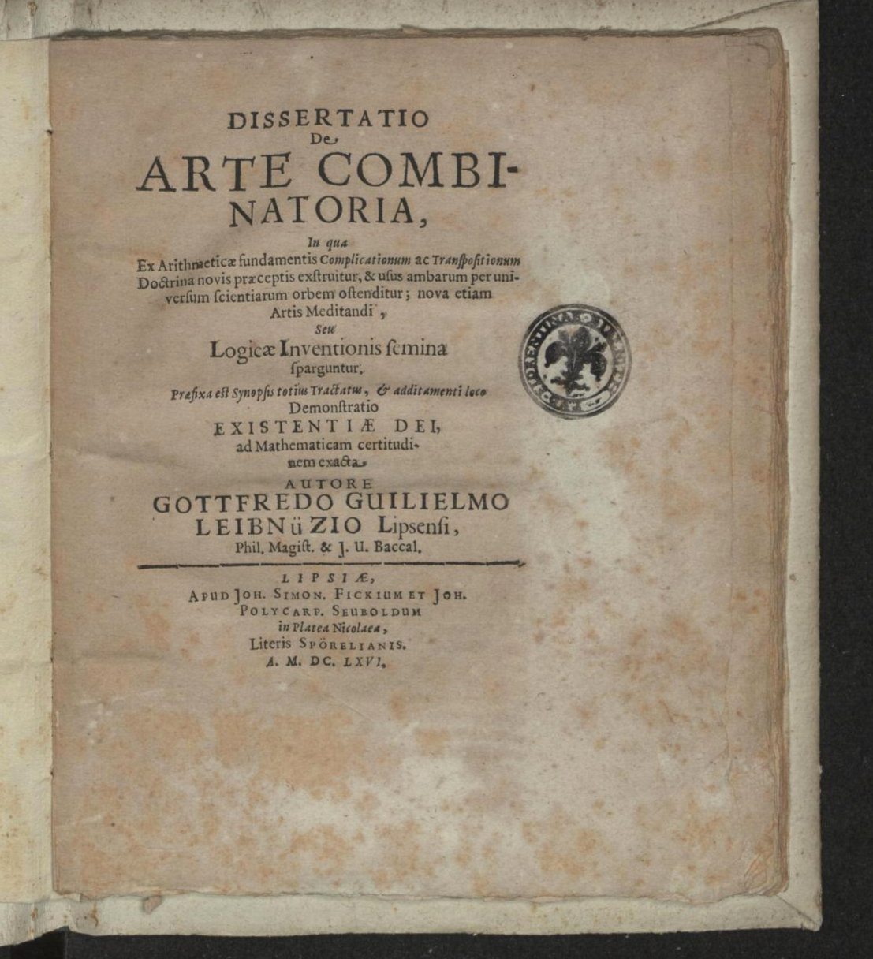
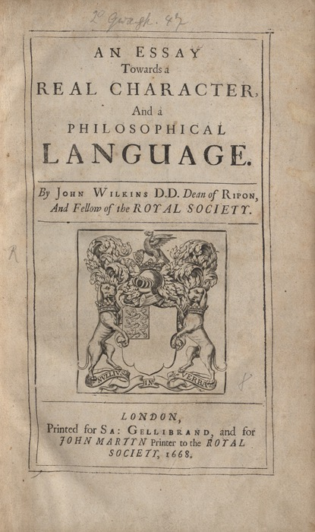
1600s
Notes:
Correspondence between Marin Mersenne and René Descartes.
Leibniz: De Arte Combinatoria (1666), discusses the alphabet of human thought, attributes to Descartes. For him, this is a first step towards the Characteristica Universalis, the perfect language which would provide a direct representation of ideas along with a calculus for the philosophical reasoning.
One of the most well developed proposals was published by the English philosopher John Wilkins (1668). The 600 page book lays out a detailed ontology on which to build a universal language, including early concepts of what might now be called universal grammar.

Slide 7
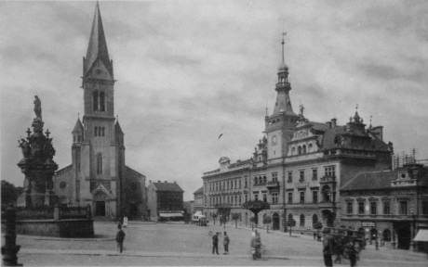
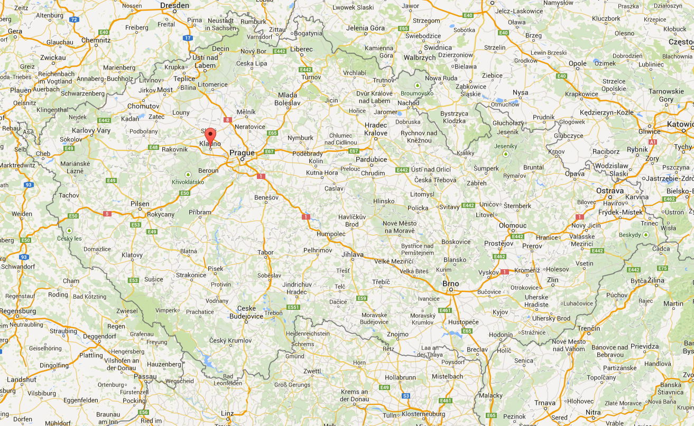
1932
18 November:
Bedřich Jelínek (Frederick Jelinek) born in Kladno
Notes:
Born to Vilem and Trude Jelink. Father was Jewish. His mother was born in Switzerland to Czech Catholic parents and had converted to Judaism.

Slide 8
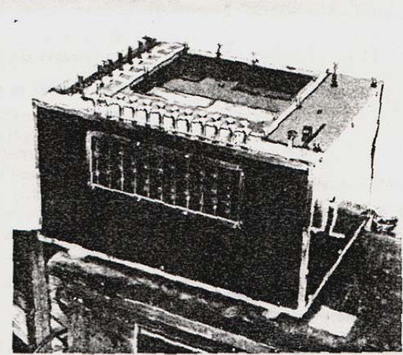
1933
22 July: Artsrouni’s “mechanical brain” patented in France
Notes:
In his 1933 description, he stated explicitly that his ‘brain’ could be adapted for the “translation of a foreign language into one of the three other languages recorded in it”, and that even
if “the existing model could operate only on these four languages… the number of languages and the number of words contained in the dictionary for each language
could be without limit.”

Slide 9
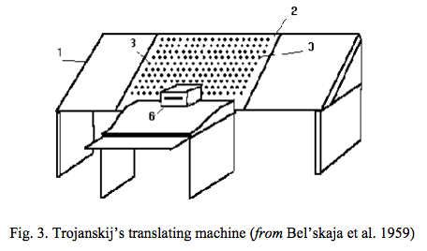
1933
5 September: Petr Troyanskii’s device patented in Russia
Notes:
The translation process itself had three stages, which in present-day terminology can be described as follows. In a “pre-editing” stage a user knowing only the source language identified stems and endings, and replaced the latter by pre-defined “logical signs”. In the second, purely mechanical, stage the entries for source word-stems were located, the corresponding target words were photographed onto a tape and, at the same time, the logical signs were typed out. In a “post-editing” stage a user knowing only the target language provided the morphologically correct target forms. In fact, Troyanskii suggested two post editors (sections §14 and §20), one to align output words and logical forms and to synthesise target-language forms, the other to make correct and appropriate lexical and structural choices.

Slide 10
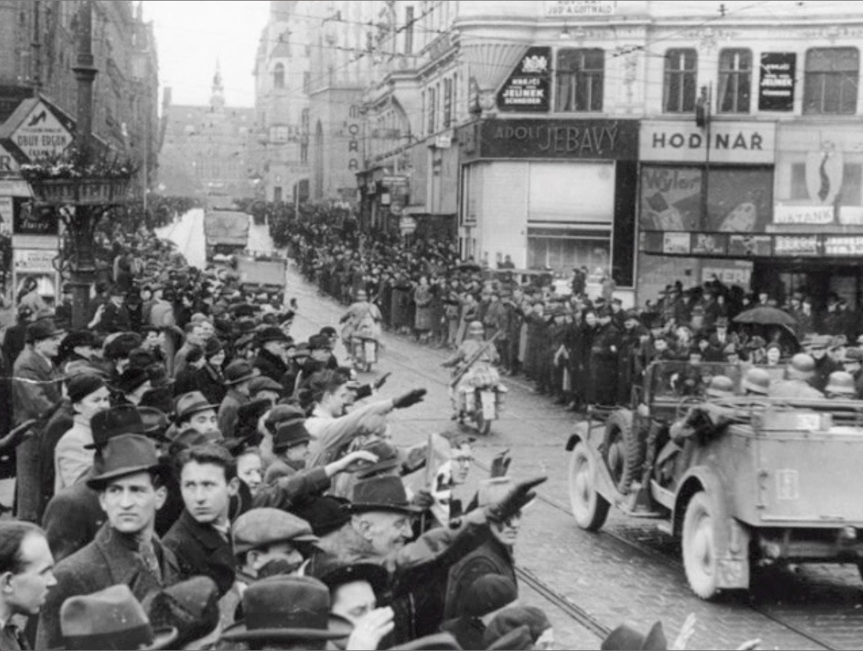
1939
March:
Nazis occupy Kladno
Notes:
Jelinek: “After the Nazi occupation, Vilem prepared everything for a departure for England, including the shipping of his dentistry tools. Although he had both a passport and a visa, he finally decided to stay put.”

Slide 11
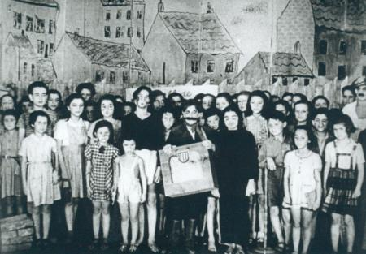
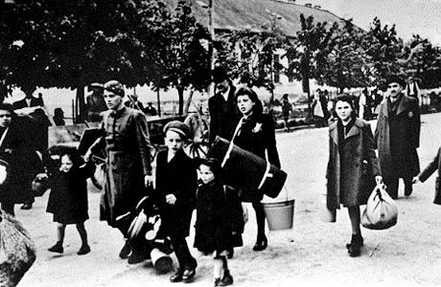
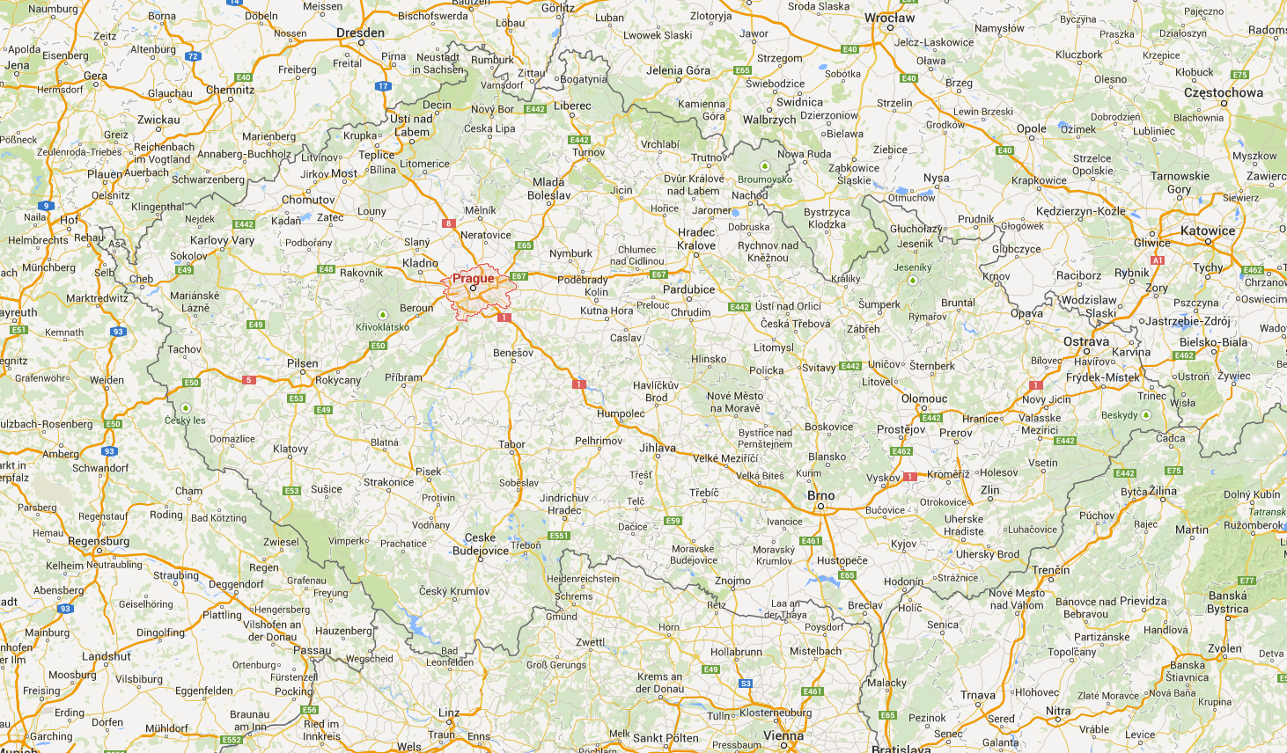
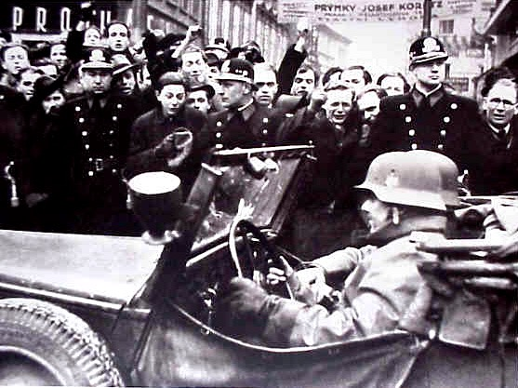
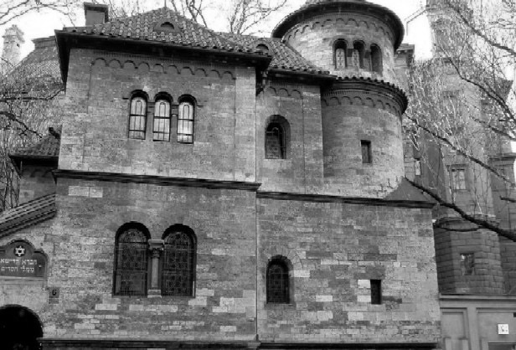
1941
Notes:
Jelinek: “My family was banished from Kladno in the summer of 41 and we found ourselves in Prague.
Beginning with the summer of 42, all instruction was forbidden. The officials of the Jewish community divided us into four "asylums" where we played games, participated in competitons, were being familiarized with different aspects of culture. For instance, the well known translator of Shakespeare E.A. Saudek talked to us lovingly about the Bard. We skated and played soccer, probably till 1944, at the old Jewish sporting club Hagibor in the suburb of Strasnice. We had to walk there from the Old Town because without special permits Jews were not allowed to use public transportation. Toward the end of the War, there remained almost none of my friends in Prague”
Vilem Jelinek was sent to the Terezin concentration camp outside Prague and died there in 1945. But the rest of the family were spared under the Nazi racial calculus: his mother, because she was not born Jewish, and the children, including a daughter, Susan, because they were deemed only half-Jewish, a lower priority.

Slide 12
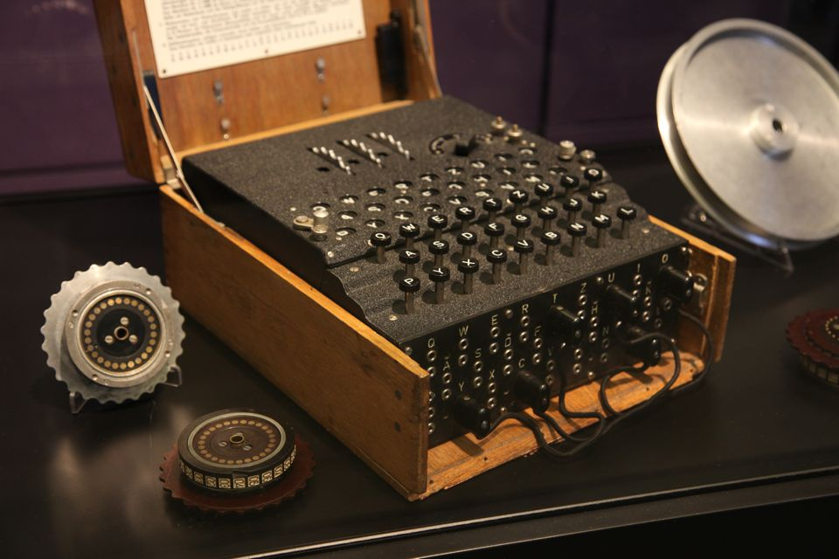
1940s
First NLP problem: the German Enigma
Notes:
mechanical polyalphabetic cipher.
Polish cipher bureau.
Alan Turing
Claude Shannon (MIT master’s thesis “A Symbolic Analysis of Relay and Switching Circuits” on electrical applications of Boolean algebra to logic).

Slide 13
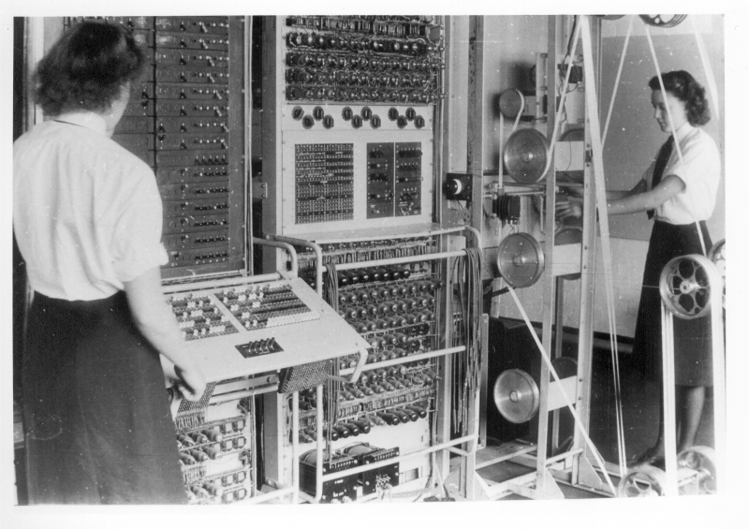
1944
5 February: Colossus becomes operational
Notes:
Machine built from vacuum tubes — used in decipherment. Dorothy Duboisson is the programmer. Declassified in 1975.

Slide 14
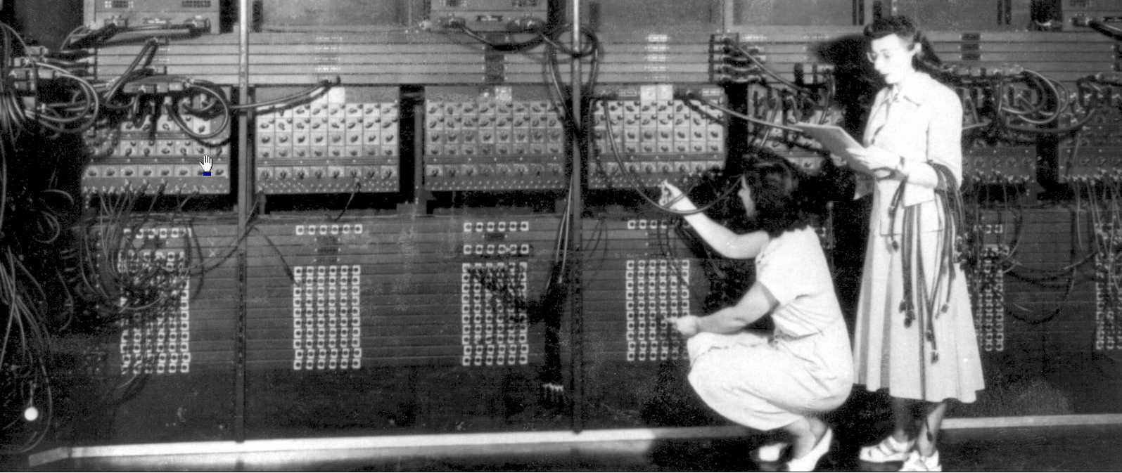
1946
14 February: ENIAC announced
Notes:
Gloria Ruth Gordon (left) and Ester Gerston (right), two of the world’s first computer programmers.
The Eniac weighed about thirty tons. It had two hundred decimal digits of storage organized as twenty signed ten-digit integers and could do three hundred fifty multiplications per second. As you can probably figure out, each digit weighed about three hundred pounds.

Slide 15
Beginnings
Notes:
Most researchers in machine translation trace the origin of the field to a letter written in 1947 by a prominent scientist, Warren Weaver, to Norbert Wiener, a professor of mathematics and philosophy at MIT.
Who has heard of Warren Weaver?

Slide 16
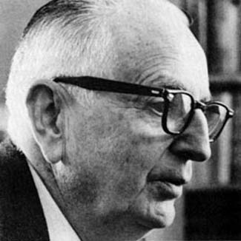
1947
“One thing I wanted to ask you about is this. A most serious problem, for UNESCO and for the constructive and peaceful future of the planet, is the problem of translation, as it unavoidably affects the communication between peoples. Huxley has recently told me that they are appalled by the magnitude and the importance of the translation job.”
–Warren Weaver to Norbert Wiener
Notes:
“One thing I wanted to ask you about is this. A most serious problem, for UNESCO and for the constructive and peaceful future of the planet, is the problem of translation, as it unavoidably affects the communication between peoples. Huxley has recently told me that they are appalled by the magnitude and the importance of the translation job.”

Slide 17
1947
“Recognizing fully, even though necessarily vaguely, the semantic difficulties because of multiple meanings, etc., I have wondered if it were unthinkable to design a computer which would translate. Even if it would translate only scientific material (where the semantic difficulties are very notably less), and even if it did produce an inelegant (but intelligible) result, it would seem to me worth while. ”
–Warren Weaver to Norbert Wiener
Notes:
“Recognizing fully, even though necessarily vaguely, the semantic difficulties because of multiple meanings, etc., I have wondered if it were unthinkable to design a computer which would translate. Even if it would translate only scientific material (where the semantic difficulties are very notably less), and even if it did produce an inelegant (but intelligible) result, it would seem to me worth while. ”

Slide 18
1947
“[A]s to the problem of mechanical translation, I am afraid the boundaries of words in different languages are too vague and the emotional and international connotations are too extensive to make any quasi mechanical translation scheme very hopeful. ”
–Norbert Wiener’s response
Notes:
Weaver went ahead anyway and in 1949 wrote a longer letter to a number of prominent scientists. Apart from its historical interest, Weaver’s letter is a really great read. Not only did it suggest that the newly invented computer could be used for translation, but it also suggested several means by which such translation could be carried out.

Slide 19
1949
“When I look at an article in Russian, I say ‘This is really written in English, but it has been coded in some strange symbols. I will now proceed to decode.’”
–Warren Weaver, “Translation”
Notes:
“When I look at an article in Russian, I say ‘This is really written in English, but it has been coded in some strange symbols. I will now proceed to decode.’”

Slide 20
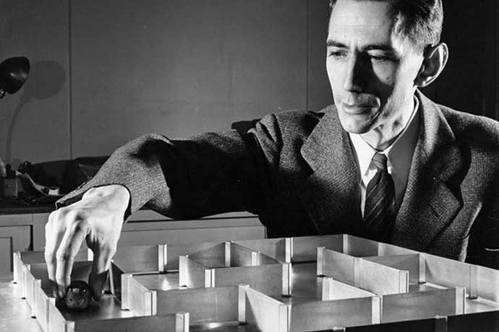
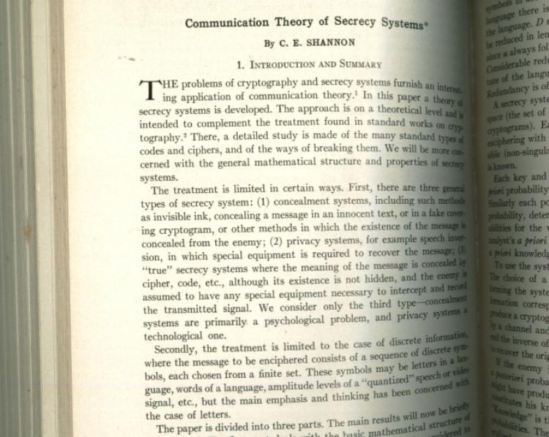
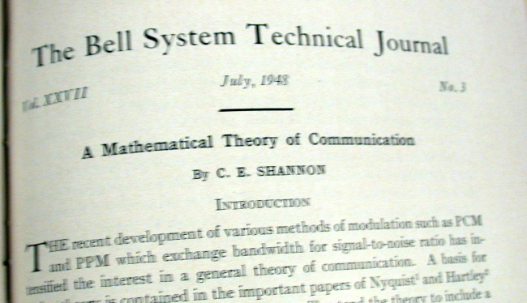
1948
Notes:
Popularized the notions of entropy (perplexity), and the noisy channel model as it is understood in information theory. Also unigrams, digrams, trigrams.

Slide 21
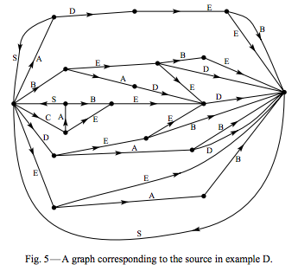
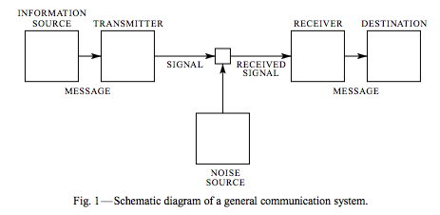
1948
“[A]ny stochastic process which produces a discrete sequence of symbols chosen from a finite set may be considered a discrete source. This will include such cases as:
1. Natural written languages such as English, German, Chinese…”
–Claude Shannon,
A Mathematical Theory of Communication

Slide 22
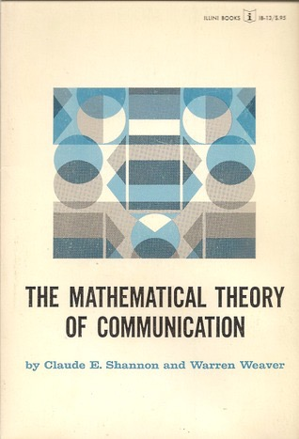
1949
Notes:
Why I asked you if you knew about WW

Slide 23
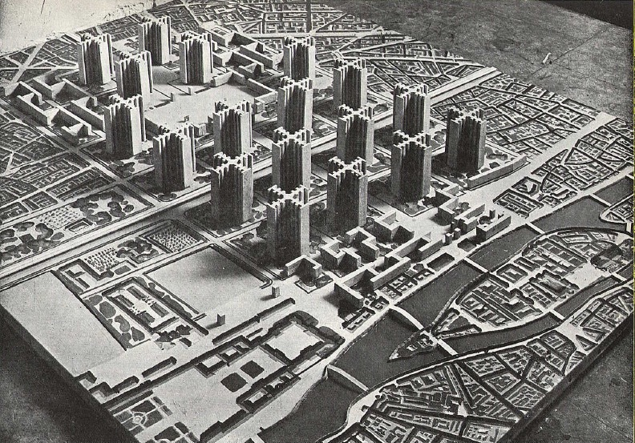
1949
“Think, by analogy, of individuals living in a series of tall closed towers, all erected over a common foundation. When they try to communicate with one another they shout back and forth, each from his own closed tower. It is difficult to make the sound penetrate even the nearest towers, and communication proceeds very poorly indeed.”
–Warren Weaver, “Translation”

Slide 24
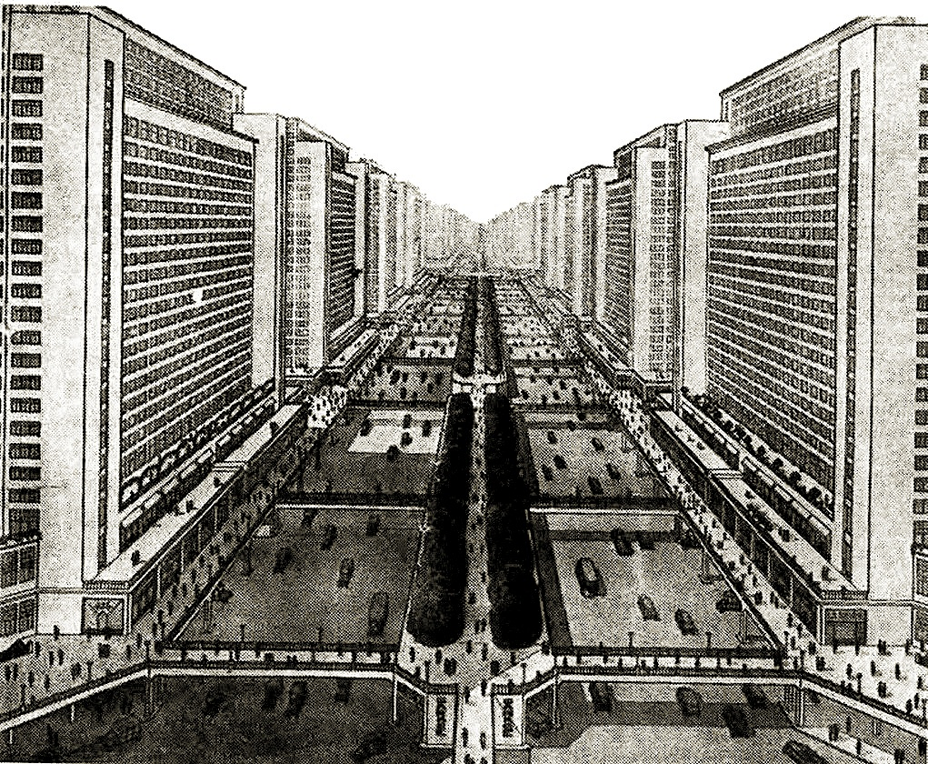
1949
“ But when an individual goes down
his tower, he finds himself in a great open basement, common to all the towers. Here he establishes easy and useful communication with the persons who have also descended from their towers. ”
–Warren Weaver, “Translation”

Slide 25
1949
“Thus may it be true that the way to translate from Chinese to Arabic, or from Russian to Portuguese, is not to attempt the direct route, shouting from tower to tower. Perhaps the way is to descend, from each language, down to the common base of human communication - the real but as yet undiscovered universal language - and then re-emerge by whatever particular route is convenient.”
–Warren Weaver, “Translation”

Slide 26
1949
“Thus may it be true that the way to translate from Chinese to Arabic, or from Russian to Portuguese, is not to attempt the direct route, shouting from tower to tower. Perhaps the way is to descend, from each language, down to the common base of human communication - the real but as yet undiscovered universal language - and then re-emerge by whatever particular route is convenient.”
–Warren Weaver, “Translation”
Notes:
The connection to Leibniz and Wilkins is hopefully obvious here.
This metaphor was so powerful that it dominated machine translation research for nearly fifty years.

Slide 27
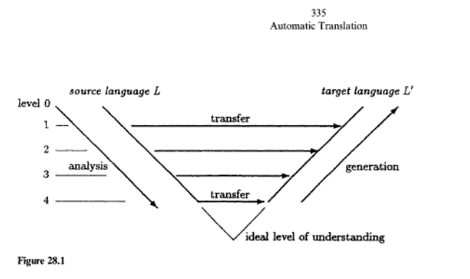
1954
Interlingual MT (from Vauquois, 1968)

Slide 28
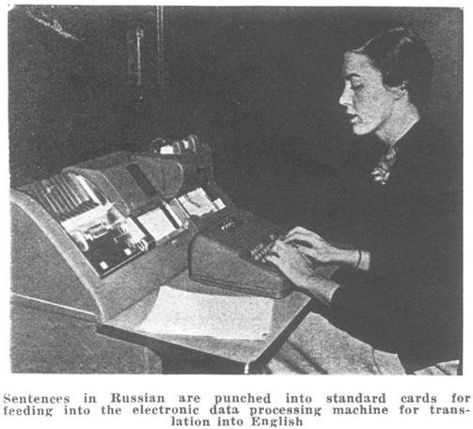
1954
Georgetown-IBM experiment
Notes:
Demo for government and public, It had only six grammar rules and 250 lexical items in its vocabulary (of stems and endings).

Slide 29
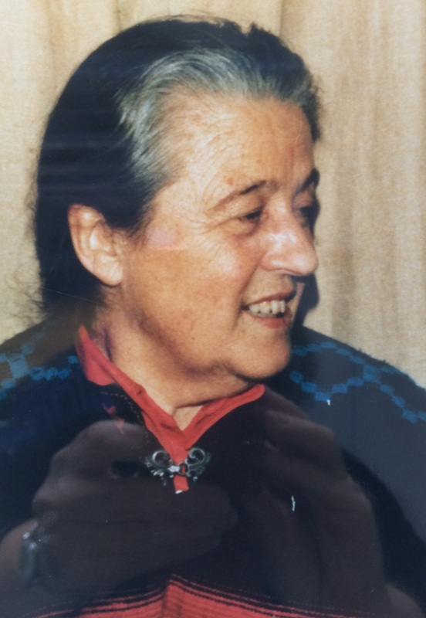
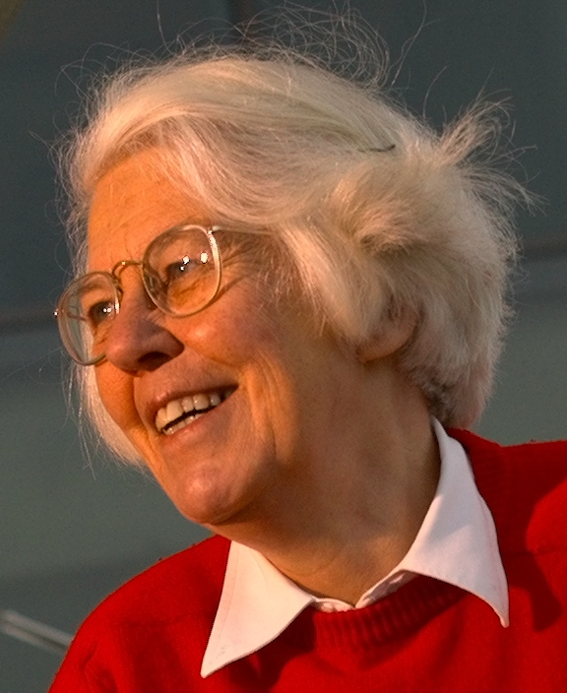
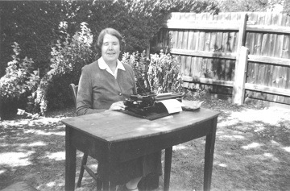
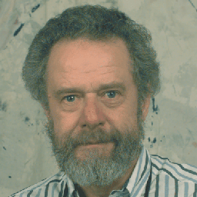
1954
Karen Sparck-Jones
Margaret Masterman founds
Cambridge Language Research Unit
Martin Kay
Notes:
Cambridge group set up under Margaret Masterman and continued for two decades, influencing NLP for many more.
* Karen Sparck-Jones influenced decades of work in semantics, discourse structure, information retrieval, information extraction, summarization. She invented inverse document frequency measure used in information retrieval.
* Martin Kay popularized finite-state approaches to morphology and dynamic programming algorithms for parsing.

Slide 30

1962
Association for Machine Translation and Computational Linguistics
founded
Notes:
Computational linguistics
Mechanolinguistics
Automatic language data processing
Natural language processing
Let’s turn back the clock a bit.

Slide 31
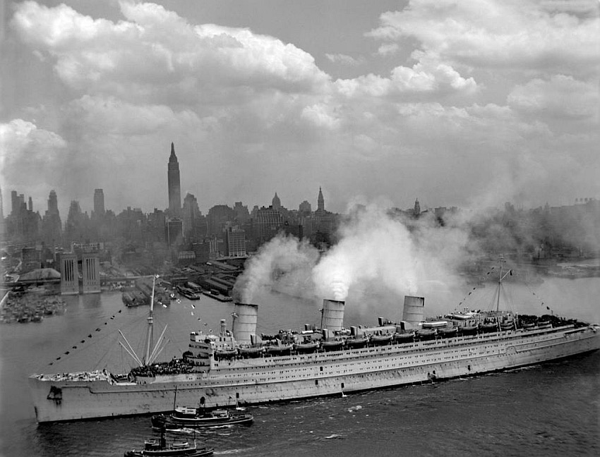
1949
Trude Jelinek and family emigrate to New York
Notes:
Fred Jelinek: It took enormous effort for my mother to succeed in emigrating. She didn't want to emulate my father's big mistake. The real reason we left for America was that my mother wanted to safeguard for me the opportunity to be educated: in 1949 it seemed very likely that the Communist regime will never allow me to attend any university. Upon her arrival she earned her living as a cook, first for families and later in restaurants. I completed high school and then contributed to the family economically by working in a factory in New Jersey to which I commuted by bus across the river Hudson.

Slide 32
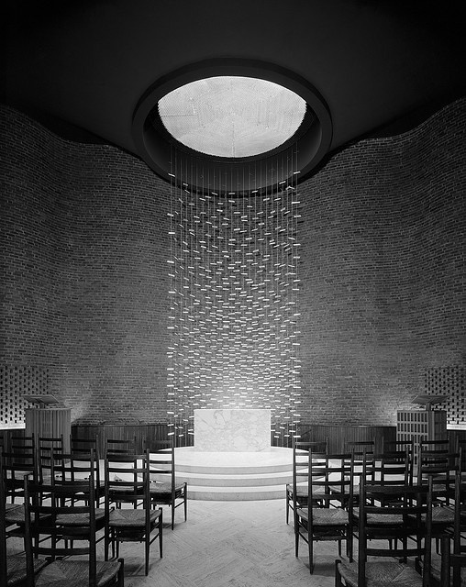
1954
Fred Jelinek moves to MIT
MIT chapel, 1955
Notes:
Information Theory seemed to be one of the most prestigious disciplines during my
years as a student at MIT (1954–1962). The faculty included the founders of the field—
Shannon, Fano, Elias, and others. Not daring to approach
Shannon himself, I asked Professor Fano to be my thesis adviser.

Slide 33
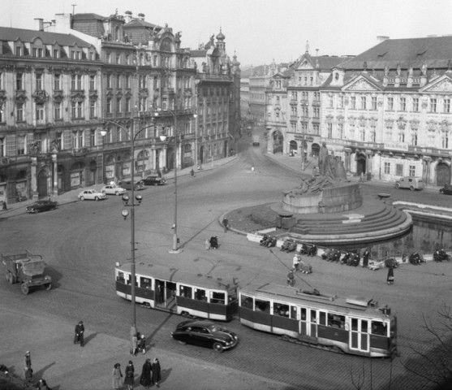
1957
Notes:
In 1957 after a trip to Vienna, Jelinek visited old friends in Prague, where he met Milena Tobolová, a colleague of his friend Miloš Forman (director of One Flew Over the Cuckoo’s Nest and Amadeus). Gradually, they became close and eventually they decided to marry. However, their application for marriage was denied on several occasions by communist authorities. In 1960, Frederick Jelinek was proclaimed "persona non grata" in Czechoslovakia and his planned visits were banned permanently. As an inaugural gift to Kennedy, the Czechs released nine dissidents and one of them was Milena Tobolová. The Jelineks soon married and Milena took up a studentship in a new PhD program that had just started at MIT: linguistics.

Slide 34
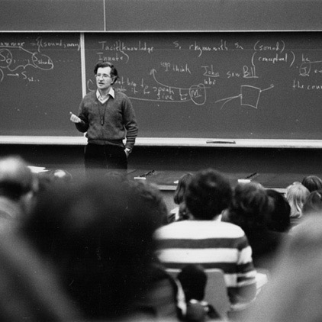
1960
Fred Jelinek considers move into linguistics
Notes:
Fred Jelinek: So Milena started attending lectures, several of them taught by Noam Chomsky. I sat in with her and got the crazy notion that I should switch from Information Theory to Linguistics. I went so far as to explore this notion with Professor Chomsky. Of course, word got around to my adviser Fano, whom it really upset. He declared that I could contemplate switching only after I had received my doctorate in Information Theory. I had no choice other than to obey. Soon thereafter, my thesis almost finished, I started interviewing at universities for a faculty position.

Slide 35
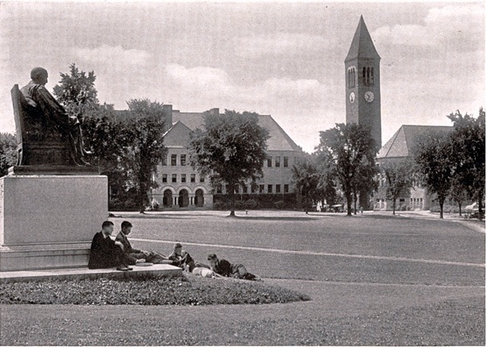
1962
“After my job talk at Cornell I was approached by the
eminent linguist Charles Hockett, who said that
he hoped that I would accept the Cornell offer
and help develop his ideas on how to apply
Information Theory to Linguistics. That decided me.”
–Fred Jelinek

Slide 36
1962
“Surprisingly, when I took up my post in the fall of 1962, there was no sign of Hockett. After several months I summoned my courage and went to ask him when he wanted to start working with me.”
–Fred Jelinek

Slide 37
1962
“He answered that he was no longer interested, that he now concentrated on composing operas.”
–Fred Jelinek

Slide 38
1962
“Discouraged a second time, I devoted the next ten years to Information Theory.”
–Fred Jelinek

Slide 39
Winter
Notes:
So, at this point we have very exciting times for both linguistics, information theory, and potentially, their intersection. But difficulties were on the horizon.

Slide 40
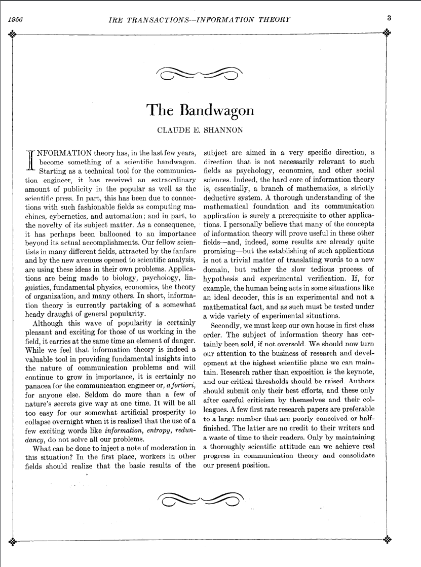
1956
Notes:
INFORMATION theory has, in the last few years, become something of a scientific bandwagon. Starting as a technical tool for the communication engineer, it has received an extraordinary amount of publicity in the popular as well as the scientific press. In part, this has been due to connections with such fashionable fields as computing machines, cybernetics, and automation; and in part, to the novelty of its subject matter. As a consequence, it has perhaps been ballooned to an importance beyond its actual accomplishments. Our fellow scientists in many different fields, attracted by the fanfare and by the new avenues opened to scientific analysis, are using these ideas in their own problems. Applications are being made to biology, psychology, linguistics, fundamental physics, economics, the theory of organization, and many others. In short, information theory is currently partaking of a somewhat heady draught of general popularity. Although this wave of popularity is certainly pleasant and exciting for those of us working in the field, it carries at the same time an element of danger. While we feel that information theory is indeed a valuable tool in providing fundamental insights into the nature of communication problems and will
continue to grow in importance, it is certainly no panacea for the communication engineer or, a fortiori, for anyone else.

Slide 41
1956
“Seldom do more than a few of nature’s secrets give way at one time. It will be all too easy for our somewhat artificial prosperity to collapse overnight when it is realized that the use of a few exciting words like information, entropy, redundancy, do not solve all our problems.”
–Claude Shannon, “The Bandwagon”
Notes:
But information theoretic ideas were also under attack in linguistics.

Slide 42
1957
“I think we are forced to conclude that ... probabilistic models give no particular insight into some of the basic problems of syntactic structure.”
–Noam Chomsky, “Syntactic structures”
“[I]t must be recognized that the notion of ‘probability of a sentence’ is an entirely useless one, under any known interpretation of this term.”
–in “Challenges to empiricism” (1969)
Notes:
Under this argument, linguistics began to take a sharp turn away from any form of empiricism, which included information theory.

Slide 43
1960
“Let me finish… by warning in general against overestimating the impact of statistical information on the problem of MT and related questions. I believe that this overestimation is a remnant of the time, seven or eight years ago, when many people thought that the statistical theory of communication would solve many, if not all, of the problems of communication… it is my impression that much valuable time of MT workers has been spent on trying to obtain statistical information whose impact on MT is by no means evident.”
–Yehoshua Bar-Hillel, “The present status of automatic translation of languages”
Notes:
Under mounting criticism, the US government commissioned an evaluation of the machine translation work that it had been funding. It was headed by John Pierce, an eminent scientist who had invented the transistor while at Bell Labs.

Slide 44
1966
“‘Machine Translation’ presumably means going by algorithm from machine-readable source text to useful target text, without recourse to human translation or editing. In this context, there has been no machine translation of general scientific text, and none is in immediate prospect.”
The ALPAC report
Notes:
This report basically killed research in machine translation for decades in the United States. What is less well known is that advocated basic research in linguistics.

Slide 45
1966
“The computer has opened up to linguists a host of challenges, partial insights, and potentialities. We believe these can be aptly compared with the challenges, problems, and insights of particle physics. Certainly, language is second to no phenomenon in importance. And the tools of computational linguistics are considerably less costly than the multibillion-volt accelerators of particle physics. The new linguistics presents an attractive as well as an extremely important challenge”
–John R. Pierce, in preface to the ALPAC report

Slide 46
1968
Association for Machine Translation and Computational Linguistics
changes its name to
Association for Computational Linguistics

Slide 47
1973
“The most notorious disappointments, however, have appeared in the area of machine
translation, where enormous sums have been spent with very little useful result, as a careful
review by the US National Academy of Sciences concluded in 1966; a conclusion not
shaken by any subsequent developments.”
–James Lighthill
Notes:
A similar conclusion was reached by the UK government within the next few years.
Cambridge Language Research Unit ceased operation in 1978

Slide 48
1978
The Cambridge Language Research Unit ceases operation.
Notes:
A similar conclusion was reached by the UK government within the next few years.
Cambridge Language Research Unit ceased operation in 1978

Slide 49
The cybernetic underground

Slide 50
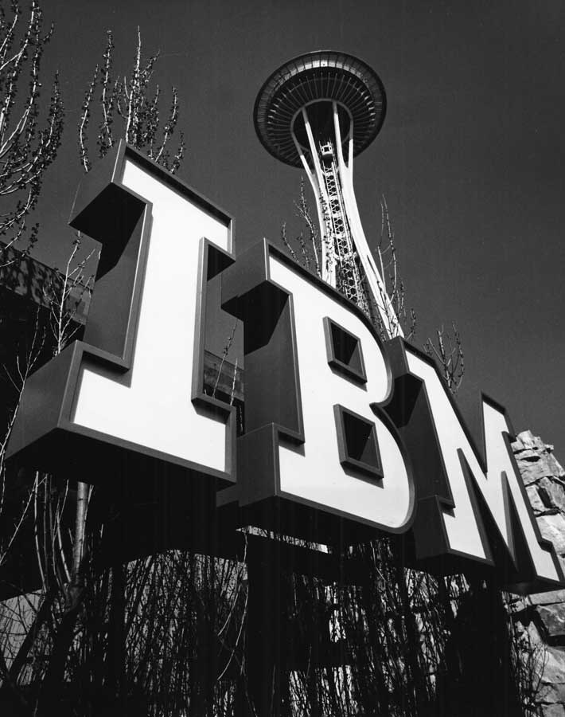
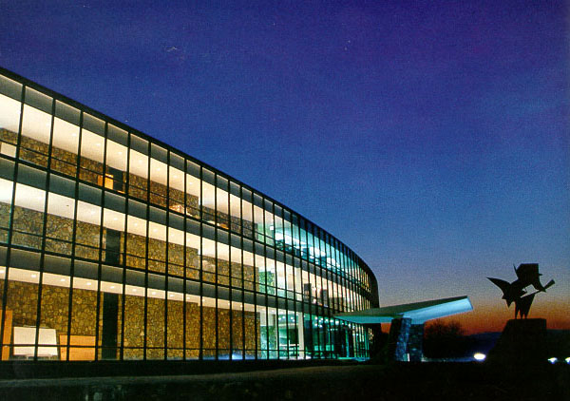
1972
Fred Jelinek goes to IBM Research for the summer
Notes:
Jelinek: I neglected to make any arrangements for work during the coming summer of 1972, so I called Joe Raviv and asked if I could spend three months in his group in Yorktown Heights. His answer was “Certainly, the sooner you arrive the
better. We are starting to work on speech recognition.”
By the time I arrived to take up that summer job, Raviv was promoted to manager
of the IBM Scientific Center in Haifa, and IBM was negotiating with Professor Jonathan
Allen of MIT to take over the speech group. These negotiations were not successful, and
several weeks later the job was offered to me. I requested Cornell to grant me a leave of
absence; they did, and I joined IBM (the following year I asked for and got another year,
but when I tried to carry out the same maneuver in 1974, I was turned down).

Slide 51
1972
Fred Jelinek goes to IBM Research for the summer
and stays there for over 20 years
Notes:
In the midst of all of the gloom around the field, why did IBM decide to start a research project on speech recognition?

Slide 52
1972
“IBM was worried that, with the advance of computing power, there might soon come a time when all the need for further improvements would disappear, and IBM business would dry up.”
–Fred Jelinek
Notes:
Who thinks of IBM as a dynamic, innovative, risk-taking company?
See the architect and the painter, about Charles and Ray Eames.

Slide 53
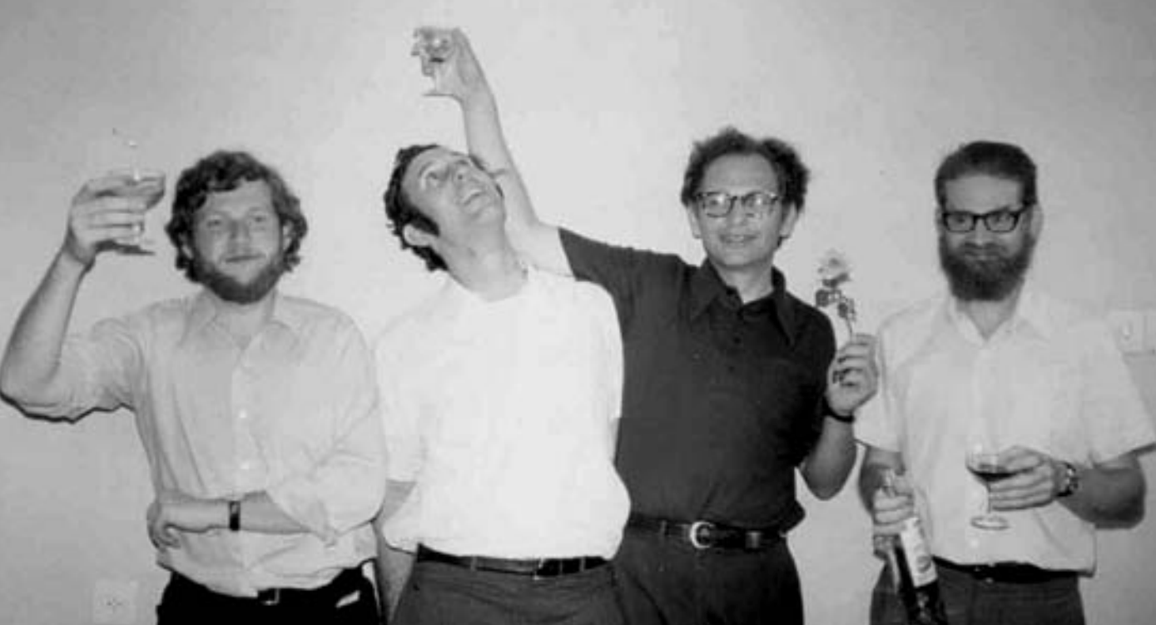
1972
Notes:
Fred Jelinek: Towards the end of the summer I took over the direction of the group and received a gift from heaven:the freshly graduated physicist Robert Mercer, who in the spring accepted an IBM job in a group that was abolished before he arrived in September.
Bob Mercer: The head of the computer science department told me to take a few weeks to look around for a group that I’d like to work in. So I did, I spoke to a number of people in the then newly-forming speech recognition group, which was intellectually headed by Fred Jelinek and Lalit Bahl, a couple of information theorists. I felt immediately with their noisy channel formulation of the speech recognition problem was the correct way to look at things, so I signed up.

Slide 54

1975
“Here’s something we jocularly called the fundamental equation of speech recognition at ICASSP in 1981. As I’m sure all of you very well know, this is just an application of Bayes’ Rule.”
–Bob Mercer
Notes:
By 1975 the group had established the basic mathematics of an information-theoretic approach to speech recognition.

Slide 55
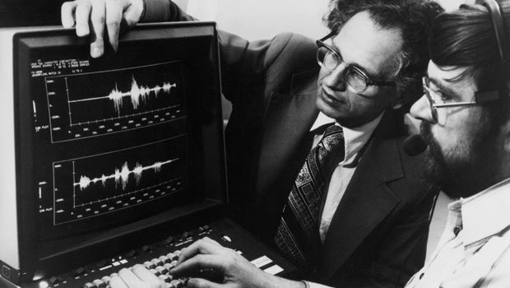
1981
Notes:
But one thing they needed to make it work was data. They estimated that they needed audio paired with about half a million words of text using a quite small vocabulary of less than a thousand words. They investigated many different sources of data, including Voice of America broadcasts, children’s books typed in manually, and texts from the US patent office.

Slide 56
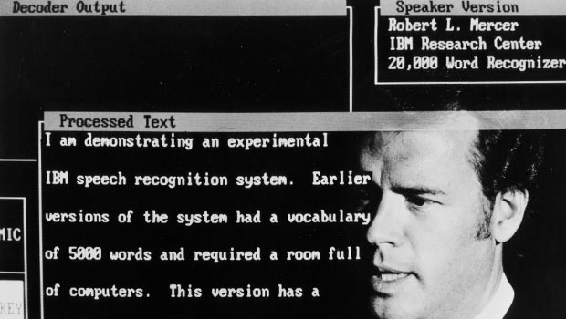
1984
Notes:
In 1978 (or so), we thought it was time to abandon artificial grammars and to start
recognizing “natural” speech. We settled on a 5,000-word vocabulary and set ourselves
the task of recognizing read sentences from an IBM internal correspondence corpus.
Our ambition was to use a combination of IBM array processors to achieve essentially
real-time performance. We fulfilled a promise to the management to achieve it by 1984.

Slide 57

1987
LDC formed, begins work on Penn Treebank
Notes:
We were not satisfied with the crude n-gram language model we were using and were “sure” that an appropriate grammatical approach would be better. Because we wanted to stick to our data-centric philosophy, we thought that what was needed as training material was a large collection of parses of English sentences. We found out that researchers at the University of Lancaster had hand-constructed a “treebank”. Because we wanted more of this annotation, we commissioned Lancaster in 1987 to create a treebank for us. Our view was that what we needed above all was quantity, possibly at some expense of quality: We wanted to extract the grammatical language model statistically and so a large amount of data was required.
Through a conversation between the IBM group, DARPA, and the university of pennsylvania, the Linguistic Data Consortium was born.
(This is the same training data as for RNNGs)

Slide 58
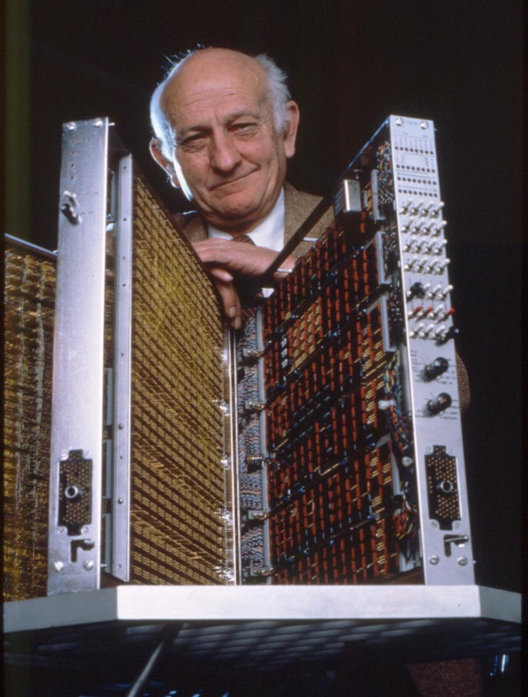
mid-1980s
John Cocke, inventor of RISC architecture, finds an interesting new dataset
(John Cocke is the “C” in CKY)
Notes:
Peter Brown: John was an absolutely wonderful and absolutely brilliant man who wandered the halls of the Watson labs, pollinating ideas from one group to another. Then after work he would wonder from one bar to another doing the same thing. We knew this because it was not unusual to receive a late night call from John, who was holed up in the phone booth in his local tavern wanting to discuss some idea or another from the latest IEEE issue on information theory. Once after a session at a conference that John attended with Lalit Bahl in Boulder, Colorado, John suggested they go out for a drink, which quickly turned into many drinks at a series of bars. Lalit was completely amazed to find that each time they entered a new bar, someone would call out, “Hey, John, it’s so good to see you, it’s been so long since you were in Boulder, let’s have a drink”. John just loved people nearly as much he loved ideas.
Anyway, at some point in the 1980s, John was on a plane, and of course he struck up a conversation with the guy next to him and then suggested they have a drink together. Before he knew it the guy was telling John about the proceedings of the Canadian House of Parliament which were kept in computer-readable form in French and in English. When he got back to the lab, John wandered over to our offices to tell us about all this text. We of course immediately acquired the data and incorporated the English text into the language models we were using for speech recognition and typing correction.

Slide 59
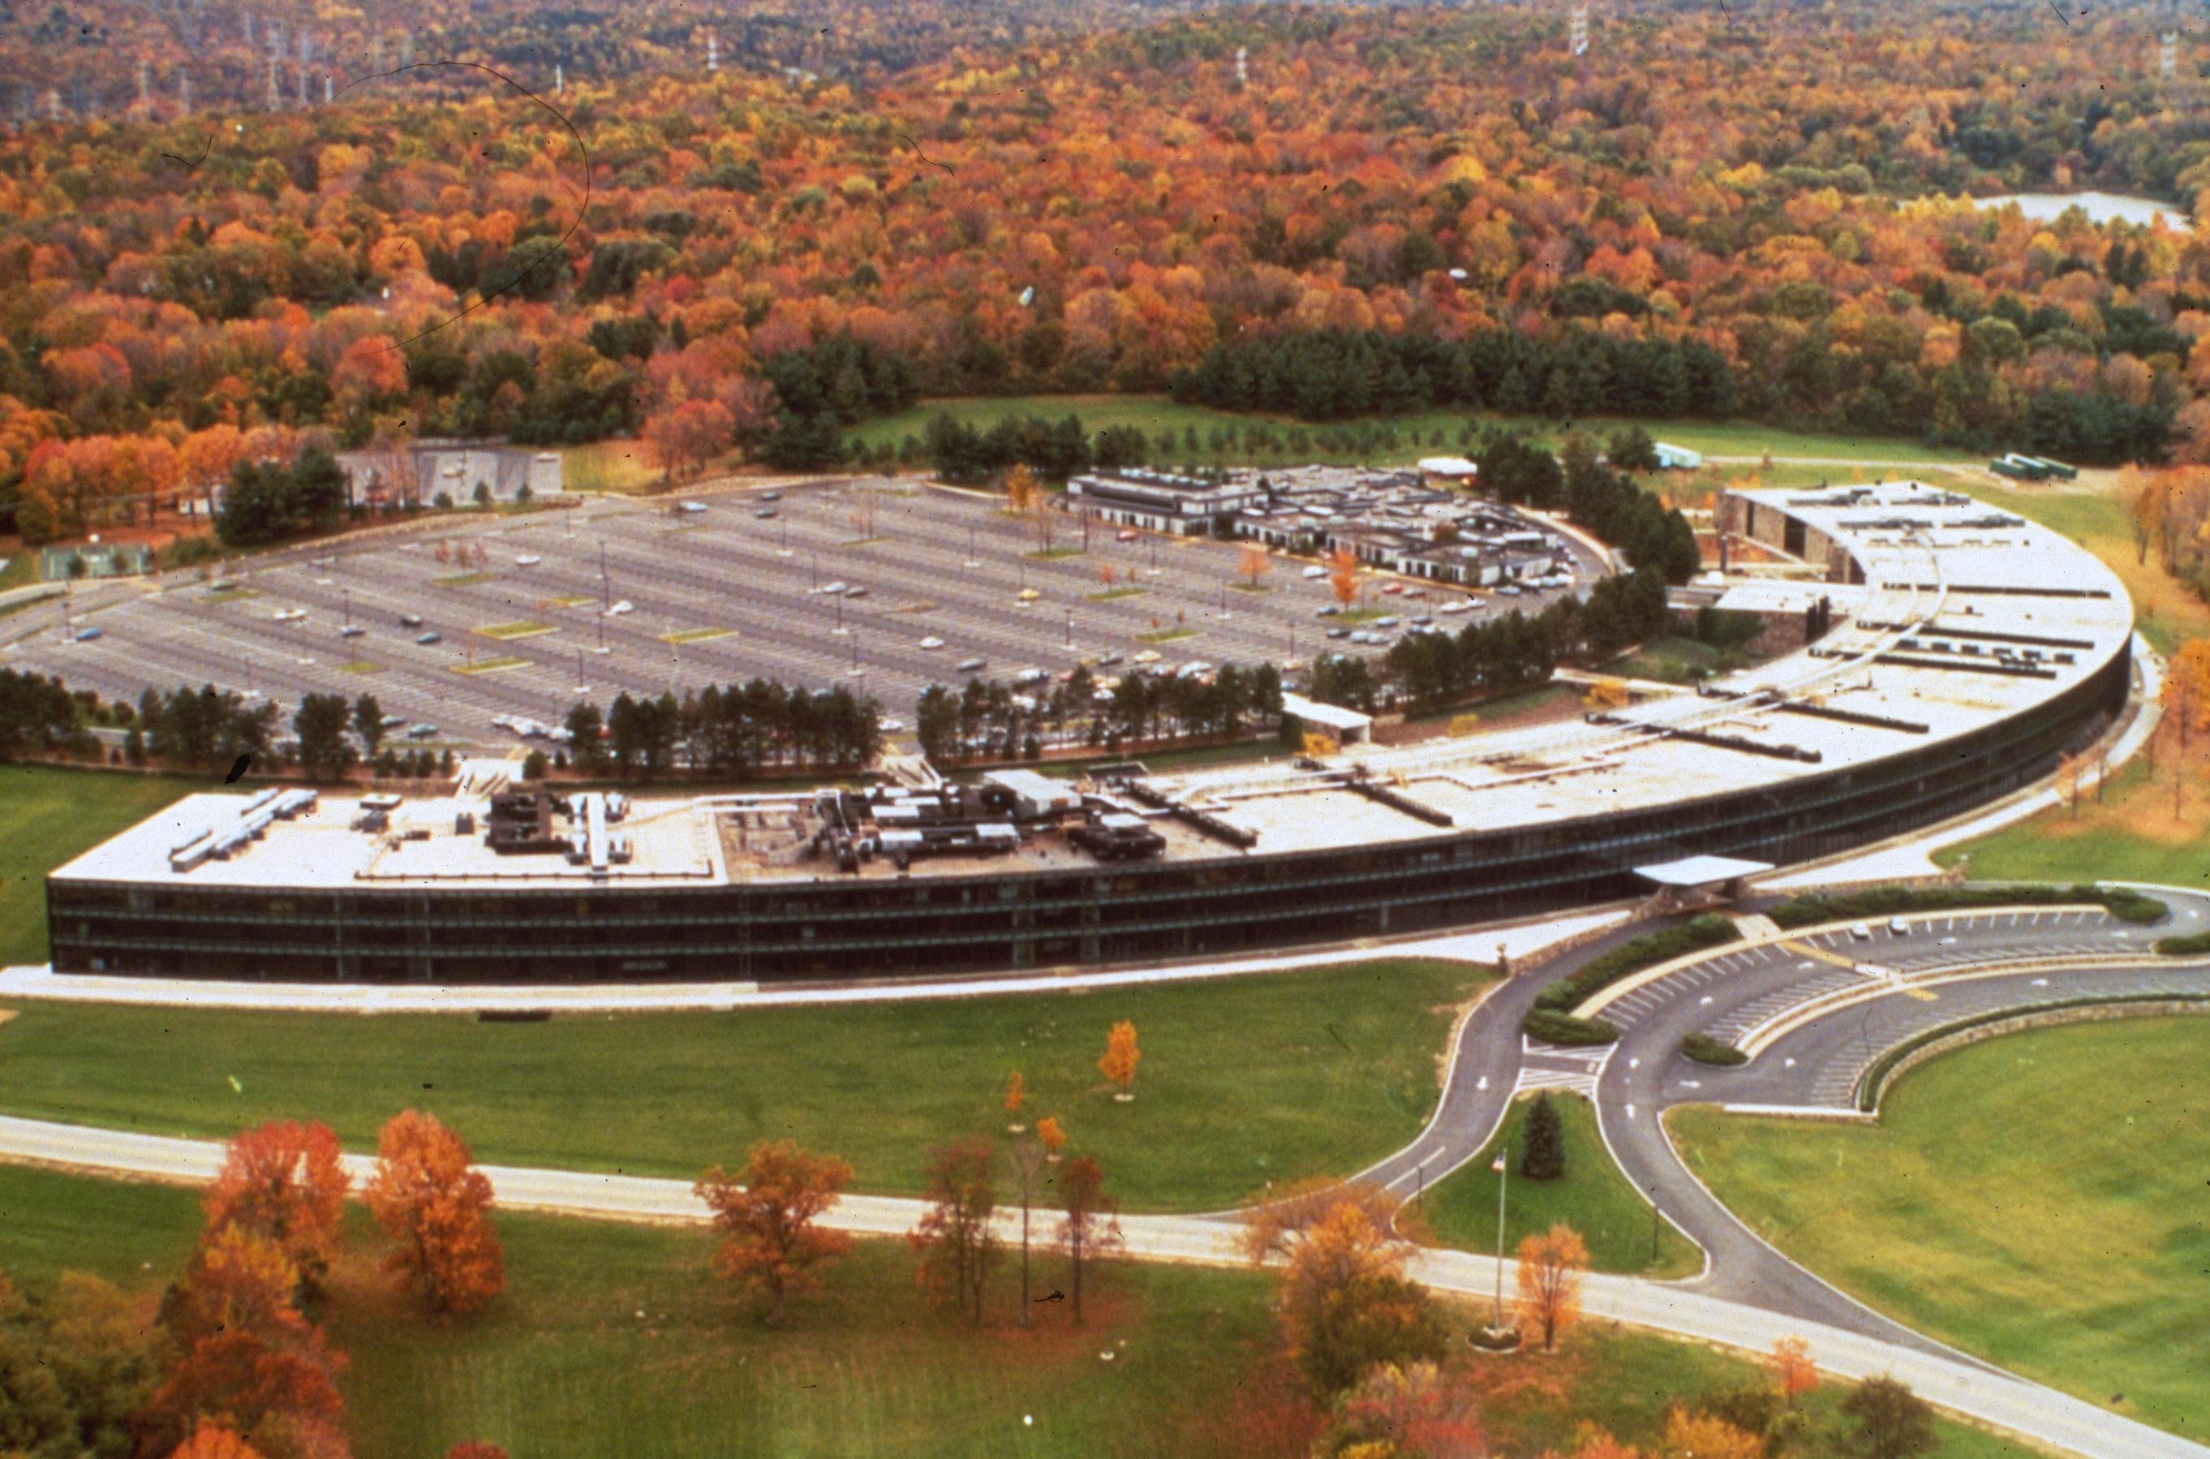
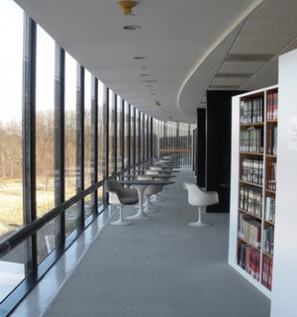
1987
Notes:
Jelinek: Some of us started to wonder in the mid 1980s whether our ASR methods could be successfully applied to new fields. Bob Mercer and I spent many of our after-lunch “periphery” walks discussing possible candidates. We soon came up with two:machine translation and stock market modeling.
Peter Brown: John Cocke kept after us to see if it might be possible to use the English and French text together to learn something about how translation works. Unfortunately, the head of our group, Fred Jelinek, was a bit of a task master, so we didn’t have any time for that. That is, until Fred took his annual summer vacation in Cape Cod. It was during Fred’s summer vacations that we entertained ourselves by trying out avant garde ideas. Every now and again, Jelinek would call in, and we’d report, “Oh, yes, everything’s right on schedule, Fred!” Then we’d go back to whatever far-fetched project we were actually working on.

Slide 60
1987
Notes:
Finally, in 1987 or 1988, we got around to looking at the French side of the Hansards data. Using a straight-forward application of dynamic programming, with a model based on sentence lengths, we attempted to line up the French and English sentences, and that worked surprisingly well. Next we decided to see if we could extract translation probabilities from co-currence statistics, and that too worked out pretty well. We began to formulate what became the basic word alignment model.
At this point, Fred came back from the beach carrying his wet blanket, but instead of reprimanding us for wasting so much time on translation, he was as excited as we were, and insisted that we write up our work. The result was a 1988 COLING paper, “A Statistical Approach to Machine Translation”. The cold water that we’d expecting from Fred instead came from some anonymous COLING reviewer who wrote,

Slide 61
1988
“The validity of a statistical (information theoretic) approach to MT has indeed been recognized, as the authors mention, by Weaver as early as 1949. And was universally recognized as mistaken by 1950 (cf. Hutchins, MT – Past, Present, Future, Ellis Horwood, 1986, p. 30 and references therein). The crude force of computers is not science. This paper is simply beyond the scope of COLING.”
–Anonymous COLING review

Slide 62

1988
“The validity of a statistical (information theoretic) approach to MT has indeed been recognized, as the authors mention, by Weaver as early as 1949. And was universally recognized as mistaken by 1950 (cf. Hutchins, MT – Past, Present, Future, Ellis Horwood, 1986, p. 30 and references therein). The crude force of computers is not science. This paper is simply beyond the scope of COLING.”
–Anonymous COLING review
“A statistical approach to language translation” 1988. P. Brown, J. Cocke, S. Della Pietra, V. Della Pietra, F. Jelinek, R. Mercer, P. Rosin. In Proc. of COLING.

Slide 63
1988
“The validity of a statistical (information theoretic) approach to MT has indeed been recognized, as the authors mention, by Weaver as early as 1949. And was universally recognized as mistaken by 1950 (cf. Hutchins, MT – Past, Present, Future, Ellis Horwood, 1986, p. 30 and references therein). The crude force of computers is not science. This paper is simply beyond the scope of COLING.”
–Anonymous COLING review
“A statistical approach to language translation” 1988. P. Brown, J. Cocke, S. Della Pietra, V. Della Pietra, F. Jelinek, R. Mercer, P. Rosin. In Proc. of COLING.
“I wonder what COLING reviews look like for papers that get rejected?”
–Peter Brown

Slide 64
1988
“The validity of a statistical (information theoretic) approach to MT has indeed been recognized, as the authors mention, by Weaver as early as 1949. And was universally recognized as mistaken by 1950 (cf. Hutchins, MT – Past, Present, Future, Ellis Horwood, 1986, p. 30 and references therein). The crude force of computers is not science. This paper is simply beyond the scope of COLING.”
–Anonymous COLING review
“A statistical approach to language translation” 1988. P. Brown, J. Cocke, S. Della Pietra, V. Della Pietra, F. Jelinek, R. Mercer, P. Rosin. In Proc. of COLING.
“I wonder what COLING reviews look like for papers that get rejected?”
–Peter Brown

Slide 65
1988
“The validity of a statistical (information theoretic) approach to MT has indeed been recognized, as the authors mention, by Weaver as early as 1949. And was universally recognized as mistaken by 1950 (cf. Hutchins, MT – Past, Present, Future, Ellis Horwood, 1986, p. 30 and references therein). The force of crude computers is not science. This paper is simply beyond the scope of COLING.”
–Anonymous COLING review
“A statistical approach to language translation” 1988. P. Brown, J. Cocke, S. Della Pietra, V. Della Pietra, F. Jelinek, R. Mercer, P. Rosin. In Proc. of COLING.
“I wonder what COLING reviews look like for papers that get rejected?”
–Peter Brown
Notes:
It is perhaps not surprising that the IBM group developed a somewhat dim view of computational lingustics of the time.

Slide 66
1988
“Every time I fire a linguist the performance of the recognizer goes up.”
–Fred Jelinek

Slide 67
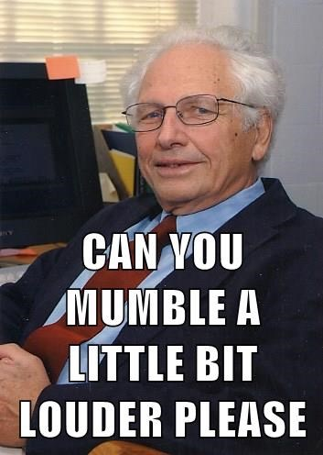
1988
“Every time I fire a linguist the performance of the recognizer goes up.”
–Fred Jelinek

Slide 68
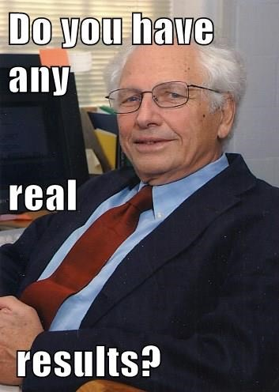
1988
“Every time I fire a linguist the performance of the recognizer goes up.”
–Fred Jelinek

Slide 69
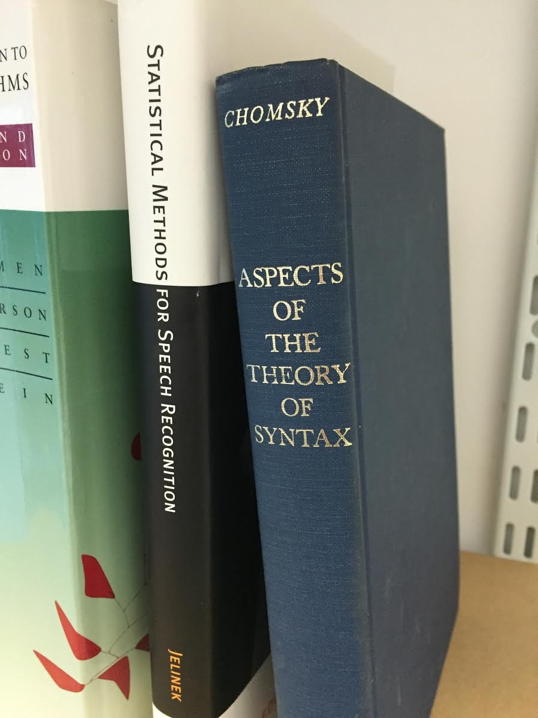

1988
“Every time I fire a linguist the performance of the recognizer goes up.”
From Fred’s library
–Fred Jelinek

Slide 70
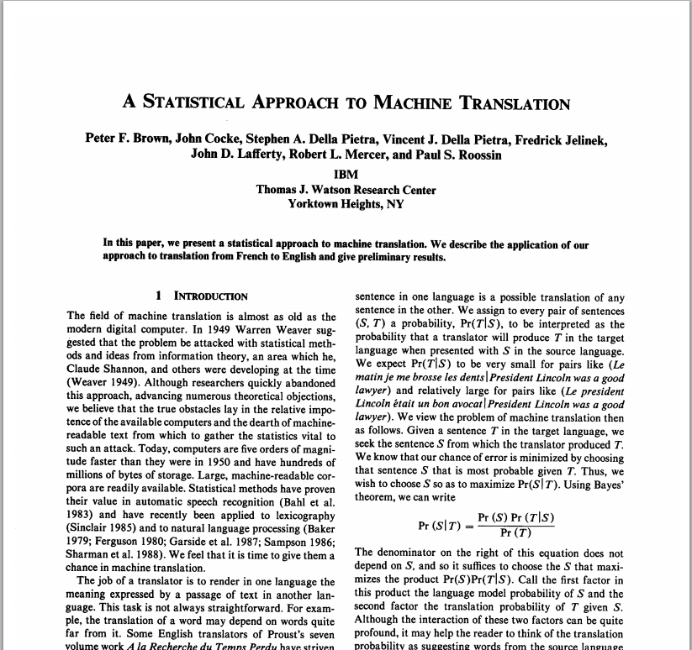
1990
Notes:
The IBM group worked out the basic alignment model and how to estimate its parameters with the EM algorithm. They then published a much better paper in 1990, adapting the source channel setup familiar to us from speech recognition. After estimating the parameters of a primitive translation model, we turned to our attention to decoding, where, unlike in speech, sentences cannot be decoded in left-to-right order. Nonetheless, the basic idea of a source model, a channel model, a stack search, and an estimate of the cost to produce those words not yet accounted for, were all the same.

Slide 71



1993
Notes:
This was incredibly expensive, and IBM was not doing particularly well, and IBM viewed the translation effort as a luxury, a luxury that we feared would be next on the chopping block; that is, unless we could bring in some outside money. They won a grant from DARPA, under the condition that they write everything down and disseminate techniques the the NLP community.
Peter Brown: It’s not that we were against the use of linguistics theory, linguistic rules, or linguistic intuition. We just didn’t know any linguistics. We knew how to build statistical models from very large quantities of data, and that was pretty much the only arrow in our quiver. We took an engineering approach and were perfectly happy to do whatever it took to make progress.
Over time the group began to incorporate more and more linguistics in to the system, and they had to develop new statistical techniques to make this work. During the early 90s to developing decision trees and maximum entry models of the source language and the noisy channel in order to incorporate more linguistic information.

Slide 72
1993
Techniques pioneered by the IBM group
Statistical models of speech, translation, syntax, and part-of-speech tagging
Triphone models (speech)
n-gram language models and smoothing
maximum entropy models
Information-theoretic clustering algorithms (Brown clustering, which Peter Brown calls Mercer clustering)

Slide 73


1993
Mercer, Brown, and the Della Pietras leave IBM
Jelinek moves to Johns Hopkins University
Notes:
Peter Brown: In early 1993, Bob and I each received a letter from some investment company in Long Island proposing that we change careers. We both just threw the letters away because we were very happy at IBM, but on the Ides of March, Bob’s mother was killed in a car accident, and his father followed 20 days later on Easter. When Nick Patterson called Bob a couple of months later to ask why he never responded to the letter, Bob decided to go out to Long Island to investigate. When he returned, he told me that I should also pay a visit. What we found was a small company housed in a high-tech incubator with tiny windows that were high up on the walls because the rooms were originally designed to be chemistry labs. The firm was headed by a mathematician named Jim Simons, who had won some big prize in geometry (Oswald Veblen). Neither Bob or I were geometers, so that didn’t mean much to us, but later we learned that Jim’s original partner was Lenny Baum, yes, the same Lenny Baum who had developed the EM algorithm that made all of our work on speech recognition, typing correction, and machine translation possible.

Slide 74
1993
Mercer, Brown, and the Della Pietras leave IBM
Jelinek moves to Johns Hopkins University
Notes:
I looked at our newborn daughter and thought about Bob struggling with college bills, and began to think that it might actually make some sense to work in the investment area for a few years. After four months of agonizing, I called George Doddington at DARPA and explained the situation, and that this investment company was offering us 50% more money than we were making at IBM. All George said was “Bye, bye”.

Slide 75
Rediscovery

Slide 76


1999
“When we looked at this paper, written in math, we thought: ‘This is really about natural language, but it has been coded in some strange symbols. We will now proceed to decode.’”
–Kevin Knight, USC/ISI
Notes:
Kevin initially proposed to do a workshop on decipherment

Slide 77


1999
GIZA toolkit (a reimplementation of the IBM models) developed at Johns Hopkins CLSP workshop
“Late in the workshop we built an MT system for a new language pair (Chinese/English) in a single day.”

Slide 78

2002
First company to commercialize statistical machine translation
Notes:
LanguageWeaver founded

Slide 79

2003
Notes:
Philipp Koehn, Kevin Knight’s PhD student
Franz Och, principal programmer on CLP workshop, postdoc at ISI
Daniel Marcu, co-founder of Language Weaver
After this paper, Daniel offered Franz position at SDL. Franz went to Google.
Philipp Koehn took a postdoc at MIT, and subsequently moved here to the University of Edinburgh

Slide 80

2005
Franz Och reports first research results reported from Google’s statistical machine translation system
Notes:
Workshop in Ann Arbor Michigan, standing room only, to many gasps of horror.

Slide 81


2006
Philipp Koehn leads development of Moses machine translation toolkit at Johns Hopkins CLSP workshop

Slide 82

2006
28 April: Google translate goes live

Slide 83

2009
Philipp Koehn writes the book on statistical machine translation

Slide 84

2009
Fred Jelinek wins ACL lifetime achievement award in Singapore
Notes:
Jelinek: I somehow slid into my scientific profession. My mother wished for me to become a physician, just like my father. My parents planned to have me educated in one of England's famous public schools. I myself wanted to be a lawyer, defender of the unjustly accused. But my career is the result of political circumstances, academic possibilities, and lucky accidents.

Slide 85

2010
14 September
Fred Jelinek dies in Baltimore
“He was not a pioneer of speech recognition, he was the pioneer of speech recognition.”
–Steve Young
“the BCJR algorithm (the J is for Jelinek) is a critical element in Turbo decoding. There is thus a little bit of Fred in every 3G cell phone on the planet.”
–Steve Wicker
Notes:
Noah Smith: When my career started, Fred was there. He offered subtle guidance. More, he paid attention. Fred made time for people who wanted to learn, no matter how green they were. He never held back disagreement or skepticism, but he was open to persuasion, especially if you could back up your argument with data. He took pleasure in seeing us stand up earnestly to his earnest challenges. In questioning, he sought understanding, and he did so with reckless abandon and not a hint of self-consciousness. He took the work seriously and never compromised on the science, but he didn’t take himself too seriously.
Good role models are hard to come by, and rarer still is a role model you seek to imitate without realizing that it’s happening. Our field, our academic family, will not be the same
without him.

Slide 86

2013
18 October: “Twenty years of bitext” in Seattle
Notes:
Peter Brown and Bob Mercer are the co-CEOs of Renaissance Technology, the hedge fund that they joined when they left IBM.
Peter Brown: Upon arrival at Renaissance, we quickly learned that the financial world is different from IBM Research. It’s ruthless. Either your models work better than the other guy’s, and you make money, or they don’t, and you go broke. That kind of pressure really focuses one’s attention. When Bob and I, and then Stephen and Vincent Della Pietra, left IBM, we just never had time to look back. Because everything is hush-hush, we lost all contact with the outside world. We went into a cocoon and focused all our energy on just staying afloat.

Slide 87
2013
18 October: “Twenty years of bitext” in Seattle
Notes:
With the exception of one minor recruiting trip, this is the first business trip either of us has taken since we spoke at the translation conference in Montreal in 1992. This past summer, my daughter was interning at the National Economic Council in Washington. One evening, I asked her what she did for them, and she told me that she’d been translating some documents from Chinese into English. I said “Wow, that must be time consuming!” She said, “Oh, not really, I just use Google translate and then clean up the results”. “What?” I asked, “Machine translation is really that good?” “Oh yeah, dad, didn’t you know that computers can translate from one language to another?” I went online and was actually shocked at how much progress you guys had made during the past 20 years.

Slide 88
2013
18 October: “Twenty years of bitext” in Seattle
Notes:
Renaissance was started by a couple of mathematicians. They had no idea how to program. So they didn’t know how to build large systems where you could make sure that this system produced the same answers that the mathematics did. From building speech recognition systems and translation systems, we learned how to build pretty big systems where you can have a lot of people working simultaneously on them, so we definitely used that skill set. Then it’s just a question of estimating parameters from a lot of data. If you look at our blackboards, they look exactly like your blackboards. Full of similar kinds of equations. The big difference in finance is that the level of noise is much greater. It’s all noise in finance and there’s more structure in natural language models.
My dream is when it all ends, to go back to what you guys are doing. What you guys are doing is much more fun.

Slide 89

2013
20 October: first modern neural MT paper presented at EMNLP
Notes:
Lest you think this is a new idea…

Slide 90
1947
“A more general basis for hoping that a computer could be designed which would cope with a useful part of the problem of translation is to be found in a theorem which was proved in 1943 by McCulloch and Pitts. This theorem states that a robot (or a computer) constructed with regenerative loops of a certain formal character is capable of deducing any legitimate conclusion from a finite set of premises.”
–Warren Weaver to Norbert Wiener
Notes:
The paper by McCulloch and Pitts is the one that introduced artificial neurons.

Slide 91

2013
Philipp Koehn nominated for European inventor award for phrase-based statistical machine translation
… and accepts professorship at Johns Hopkins University

Slide 92

2014
Franz Och leaves Google for Human Longevity Inc.
(he now works for a cancer screening company)
Notes:
If Franz is as good at optimizing human lifespans as he is at optimizing BLEU scores, you will all live a very long time.

Slide 93

2014
Bob Mercer wins ACL lifetime achievement award in Baltimore

Slide 94
1949
“[I]t is one of the chief purposes of this memorandum to emphasize that statistical semantic studies should be undertaken, as a necessary preliminary step. ”
–Warren Weaver, “Translation”

Slide 95

2014
July: 1st Frederick Jelinek memorial workshop held in Prague
on “Cross-lingual abstract meaning representation for MT”
Notes:
This is a quite long-term project. The goal is to build for semantics the kind of thing that was built for syntax in the 1980s.

Slide 96
2016
February: Google Translate decides to switch to neural machine translation

Slide 97

2016
February: Google Translate decides to switch to neural machine translation
November: Google’s first neural MT systems launched.

Slide 98

2016
February: Google Translate decides to switch to neural machine translation
November: Google’s first neural MT systems launched.

Slide 99

2016
Bob Mercer gets a lot of publicity

Slide 100

2016
Bob Mercer gets a lot of publicity
Notes:
Peter Brown lives in Washington DC with his wife Margaret Hamburg, commissioner of the U.S. Food and Drug administration under Barack Obama.

Slide 101

2017
Bob Mercer continues gets a lot of publicity

Slide 102

2017
Currently supports 104 languages, or 10,712 language pairs.
… a rate of nearly three per day, since launch on 28 April, 2006.

Slide 103
2017
Currently supports 104 languages, or 10,712 language pairs.
… a rate of nearly three per day, since launch on 28 April, 2006.
Google plans to convert all of them to neural MT by the end of the year.

Slide 104
“Research in both ASR and MT continues. The statistical approach is clearly dominant. The knowledge of linguists is added wherever it fits. And although we have made significant progress, we are very far from solving the problems. That is a good thing: We can continue accepting new students into our field without any worry that they will have to search, in the middle of their careers, for new fields of action.”
–Fred Jelinek

